Slide 1

The most common trauma presentation
Dr Terry Nash

Slide 2
Playbook
Why:
  incidence and trends
How:
  Causes
  Consequences
  Context
  Consent
  Capacity….and maybe conversations!

Slide 3
Why every ED physician must be falls expert
In Australia, falls are the leading cause of injury hospitalisations and injury deaths. In 2023–24 there were ~248,000 fall-related hospitalisations, about 43% of all injury admissions.
Transport injuries are way behind that: ~65,000 hospitalisations (11%).
In people 65+, falls absolutely dominate: in 2019–20, 77% of all injury hospitalisations and 71% of injury deaths in this age group were due to falls. Older Australians were 8× more likely to be hospitalised and 68× more likely to die from a fall than people aged 15–64.

Slide 4
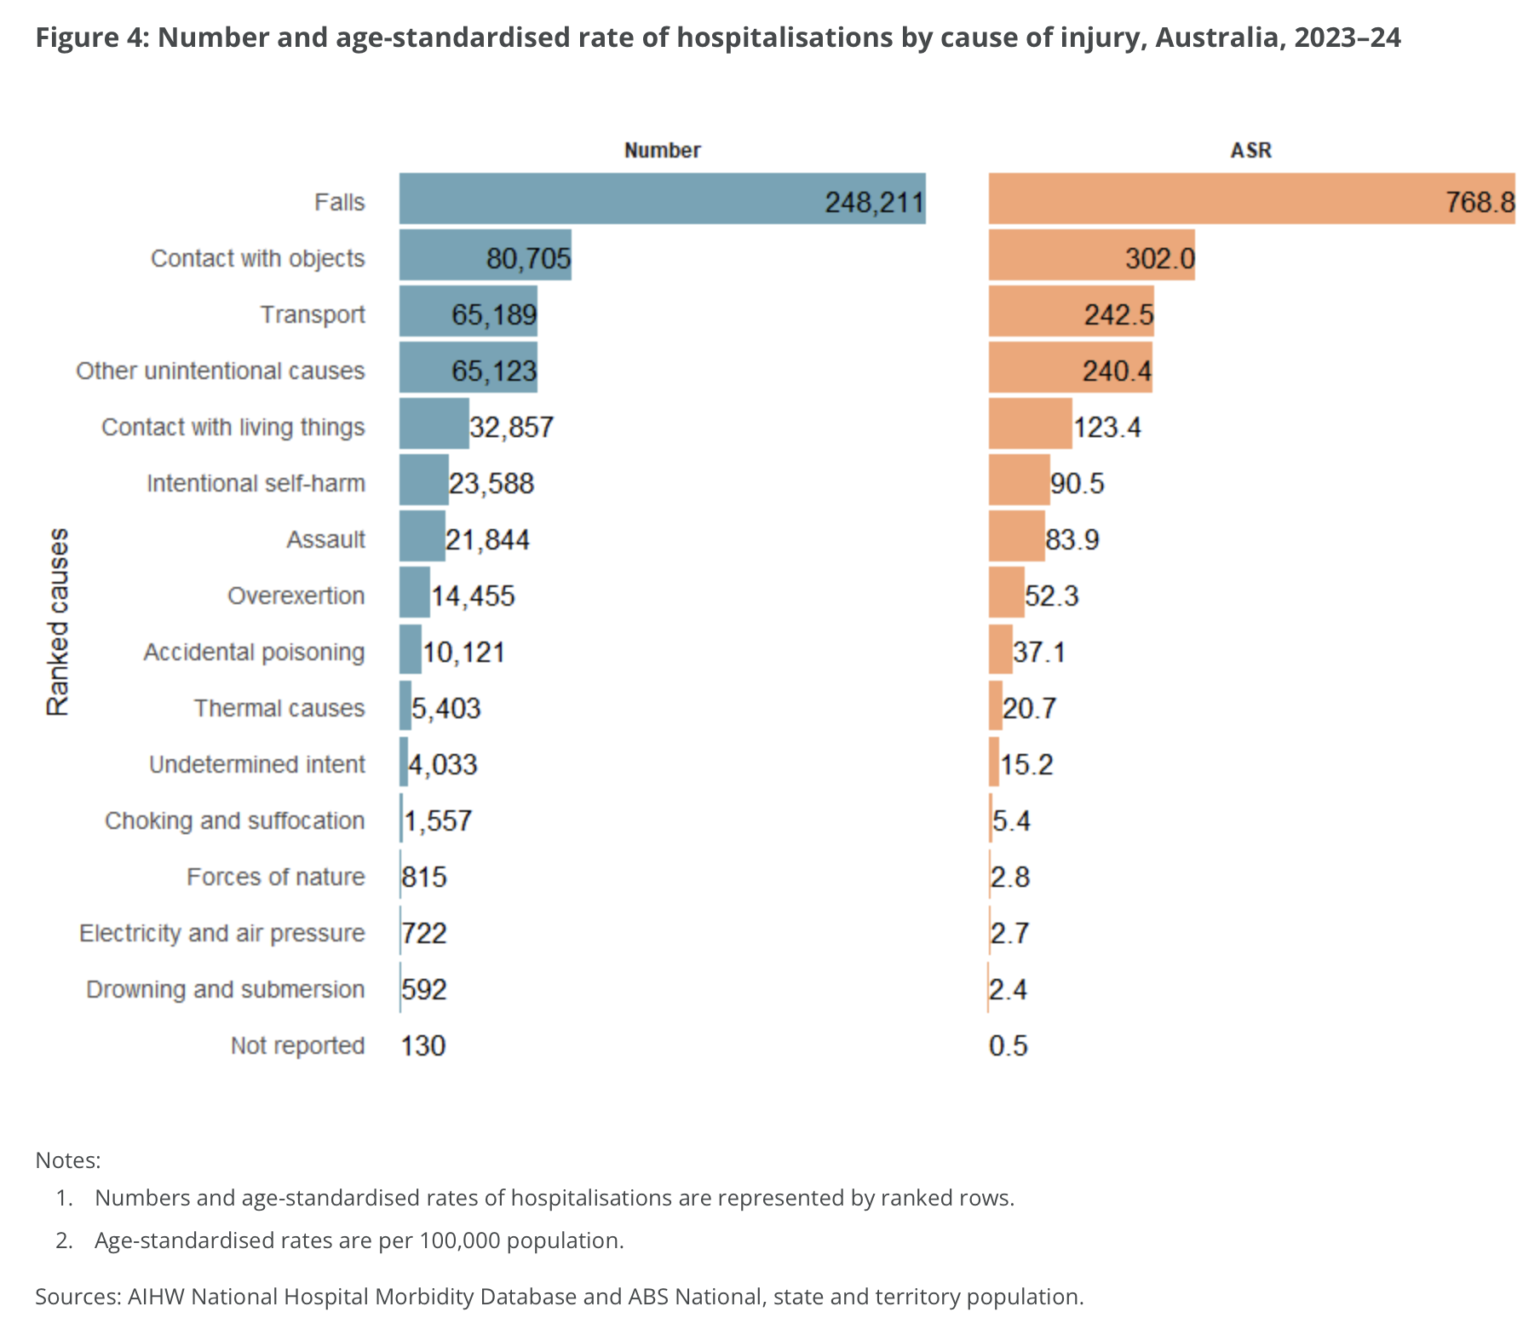
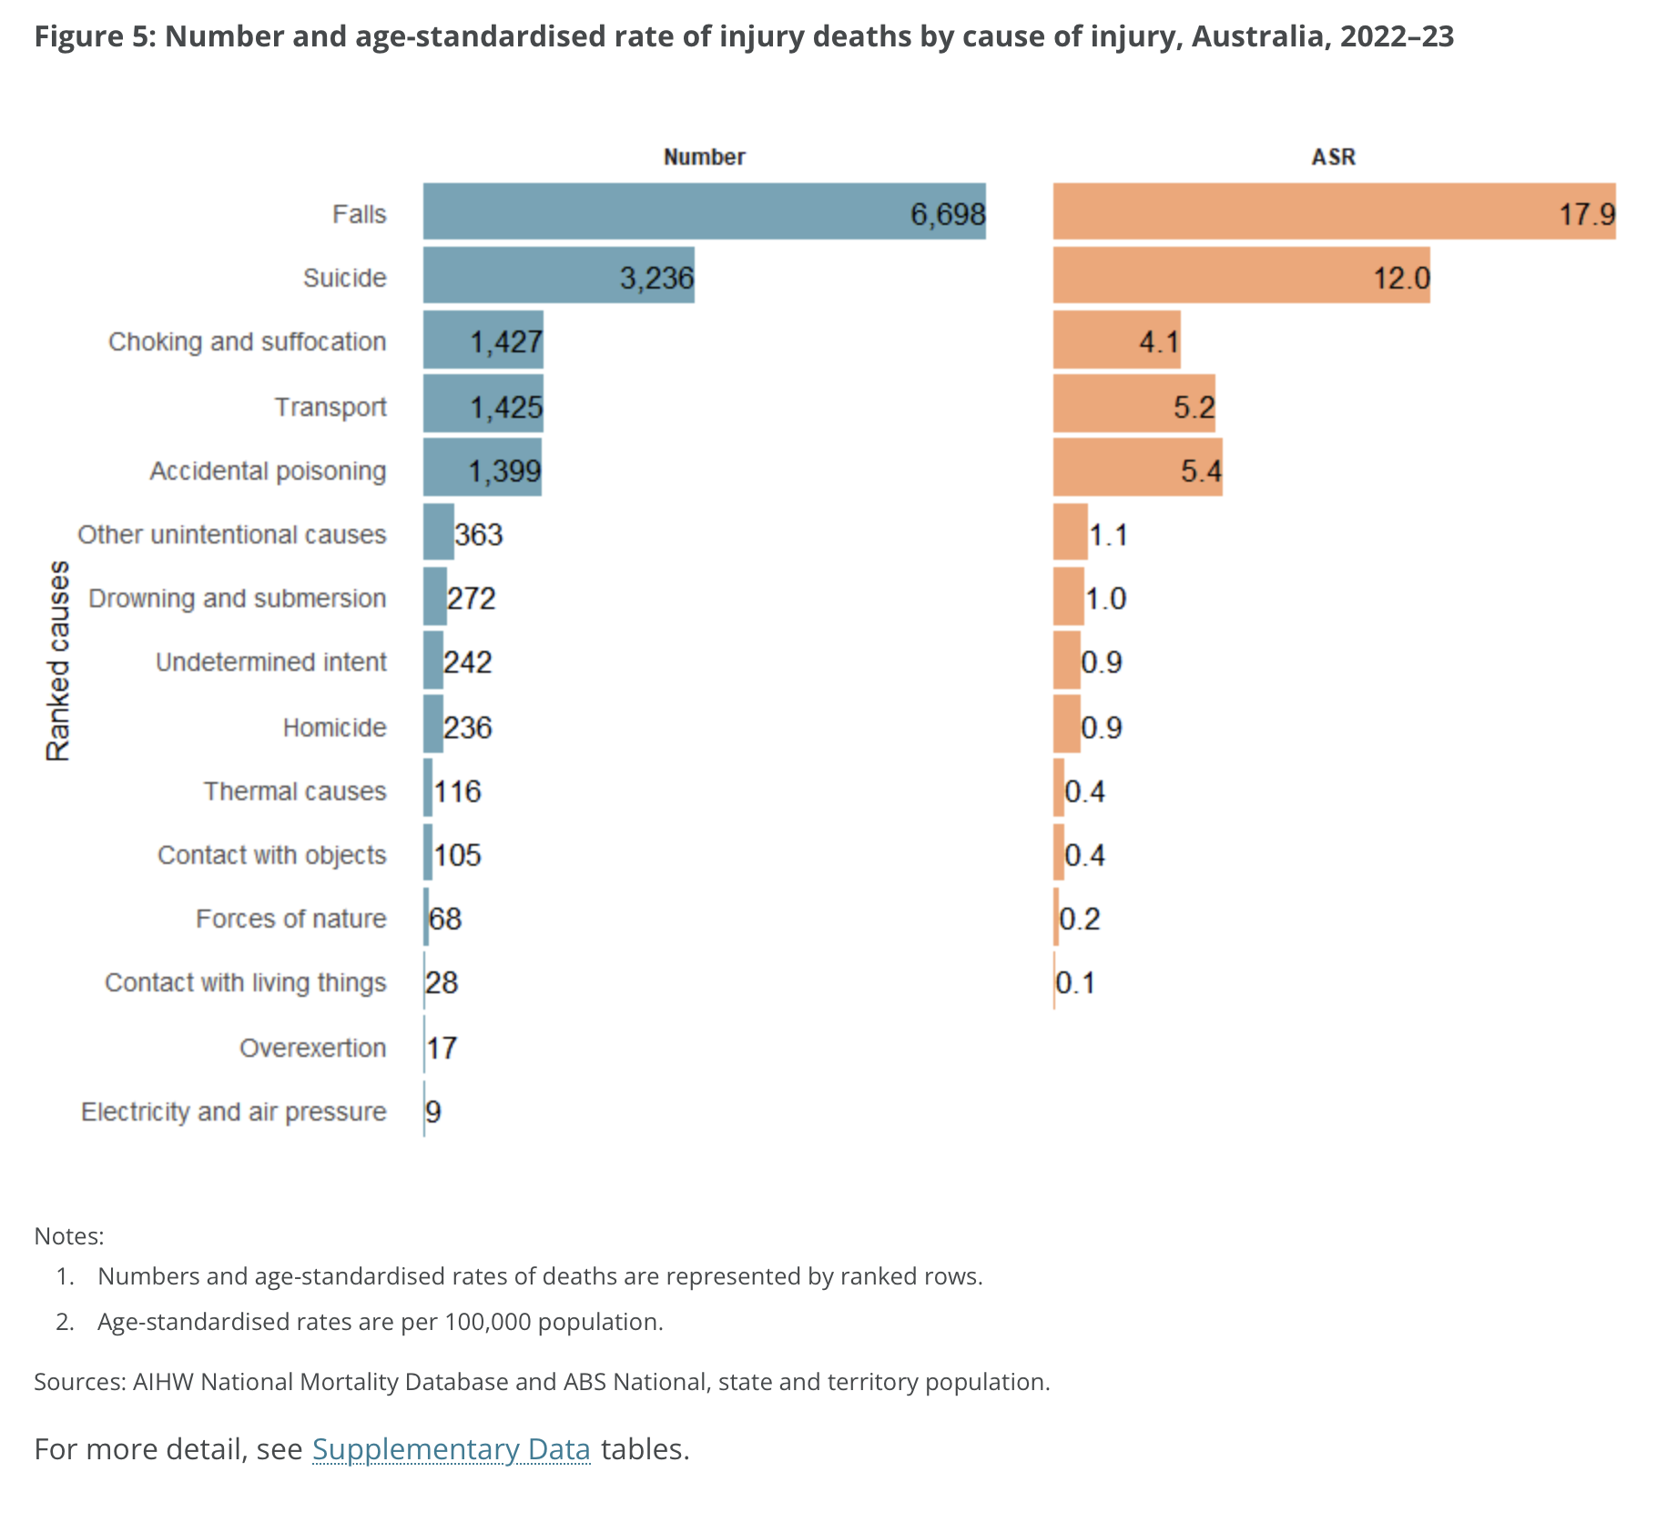

Slide 5
Mechanism of injury: not gunshots, not high‑speed MVC
From the Australia New Zealand Trauma Registry (ANZTR) 2022–23: among severely injured patients (ISS >12), mechanisms are mainly:
  Australia: 44% transport-related, 39.2% falls, 95.6% blunt trauma, ~3% penetrating.
  New Zealand: 47.2% transport, 33.3% falls, 94.8% blunt trauma.
The ANZTR explicitly notes that older people injured from low falls are now the predominant group experiencing major injury and death in Australia and NZ.
In Queensland, among people 65+, same‑level falls (trips, slips, stumbles) account for ~52% of fall‑related hospitalisations – i.e. mostly ground‑level.
In our system: If you’re not excellent at falls, you’re not excellent at trauma!

Slide 6
The “5 Cs” framework
System 1 vs System 2 (Kahneman Thinking, Fast and Slow):
  System 1: fast, automatic – “just a mechanical fall”.
  System 2: slow, effortful – “what exactly caused this fall, and what does it mean in this person’s frailty trajectory?”
Literature on “mechanical falls” shows:
  The label is inconsistently used, not linked to a specific evaluation, and does not predict outcomes or change work‑up.

Slide 7
The “5 Cs” framework
Cause – active, hypothesis‑driven search for all plausible causes
Consequence – hands‑on search for all injuries, new vs old
Context – frailty, dementia, life trajectory, risk of terminal frailty event
Capacity – decision‑ and context‑specific, supported
Consent – rights‑based involvement in health decisions, even with dementia

Slide 8
Cause: moving beyond “mechanical fall”
What is the most likely underlying cause of this fall?
  Have I considered integrative causes?
Cause is not ‘mechanical’. Cause is a series of small, explicit decisions: have I actively looked for syncope, stroke, infection, delirium, ACS, meds? If I can’t say yes to each, I’m practising System 1 medicine.

Slide 9
Consequence: you won’t find what you don’t touch
Injury pattern should emerge from three things together:
  Get the story – mechanism, point of impact, inability to mobilise, head strike, anticoagulation.
  Observe all parts of the body – undress, inspect skin, swelling, deformity.
  Touch every part – palpate spine, pelvis, ribs, long bones, hands/feet; compare bilaterally.
If you don’t undress and palpate, you are guaranteeing a missed fracture. Consequence is the easy C conceptually, but it’s hard because it takes time and touch

Slide 10
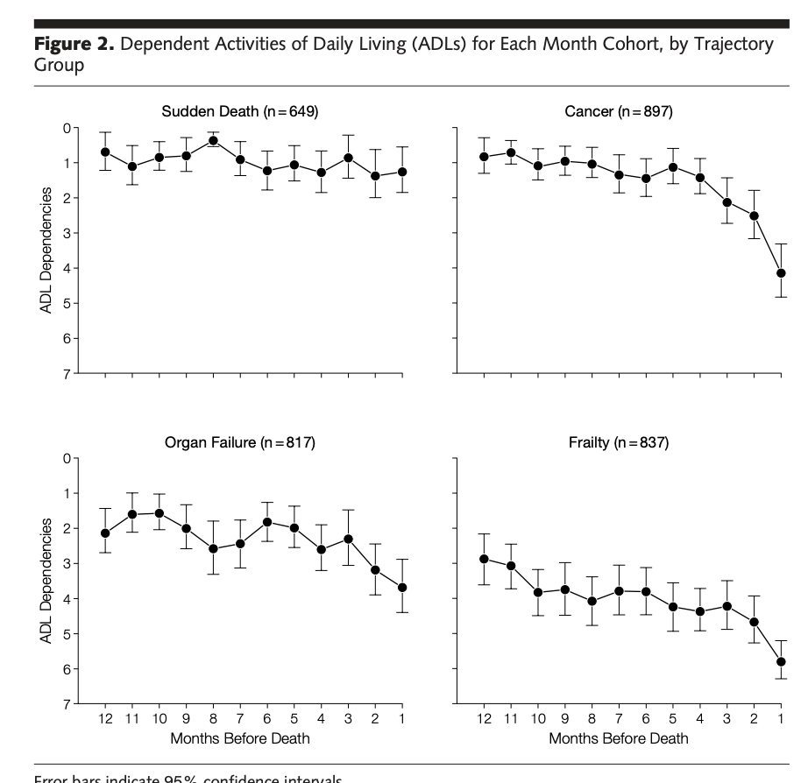
Context: Frailty as a continuum & trajectory
Has this person gone from non‑frail → frail abruptly (e.g., after a stroke or illness)?
Or is this a slow slide down the frailty slope?
Does this fall signal we may be in the final year or two of life – a terminal frailty event?

Slide 11
Capacity: decision‑specific, context‑specific, presumed
Presume capacity for this decision (e.g., CT head, admission vs home, surgery vs conservative).
Ask: can the person understand, retain, weigh and communicate the relevant information with appropriate support?
Use supporters (family, carers, registered supporters)

Slide 12
Consent: paired with capacity, rooted in rights
Consent: including the person, even with dementia, is a healthcare right
  Supported decision-making is backed by the UN Convention on the Rights of Persons with Disabilities and reflected in Australian law and policy.
  Even when substitute decision-makers are involved, it’s still best practice to involve the person in conversations about their care as far as practicable.

Slide 13
Falls as core trauma work: the 5 Cs in practice
Falls (mostly ground‑level) are the leading cause of injury hospitalisation and death, especially in older people; low falls now rival transport as causes of major trauma in AU/NZ.
How: “Mechanical fall” is a bias trap; use the serial 5C framework instead.
  Cause: Apply a structured medical differential every time – syncope, stroke, delirium, infection, meds, etc.
  Consequence: You only find what you look at and touch – undress, observe, palpate, distinguish old vs new injuries.
  Context: Think about the frailty trajectory – is this reversible frailty or a terminal frailty event? Use falls as a prompt for goals-of-care thinking.
  Capacity & Consent: Capacity is presumed, decision‑specific, supportable; consent is a core right, even in dementia.

