Slide 1
Build for emergent problems – Frailty at the front door
How the quadruple aim and the frail older person intersect
Dr Terry Nash
Friday, 26th June 2026
Gold Coast University Hospital Research Symposium
Notes:
1. Title + QR + listening styles
Suggested image: Clean title slide; QR code on the right; subtle Metro South / ED texture only
Narrative bullets:
• Title, topic, and scope were introduced.
• Multiple valid listening styles were normalised, including attentive listening, note-taking, scrolling, fact-checking, and following links in real time.
• A QR code was provided to a public resource list for the talk.
• The formal beginning of the keynote was signposted clearly.
References:
1. Brief bio: Dr Terry Nash — Senior Staff Specialist Emergency Physician, Princess Alexandra Hospital Emergency Department; CAREPACT Clinical Lead; PhD candidate, University of Queensland School of Medicine.
2. Role and candidature verification were drawn from the current keynote deck and HDR progress review source pack (internal project documents; no DOI).
3. No scholarly literature was assigned to this slide because it carried orientation and access information rather than substantive research claims.

Slide 2
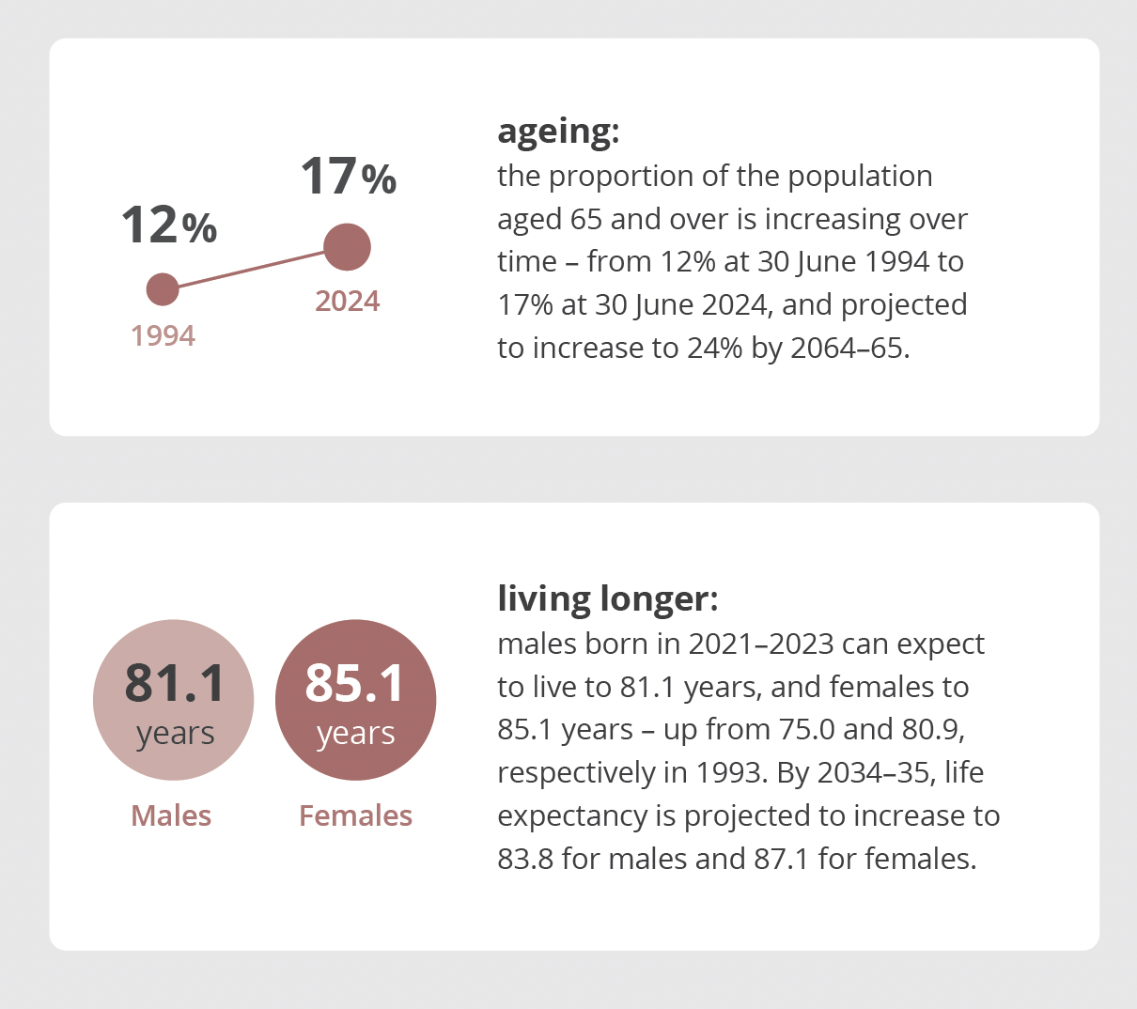
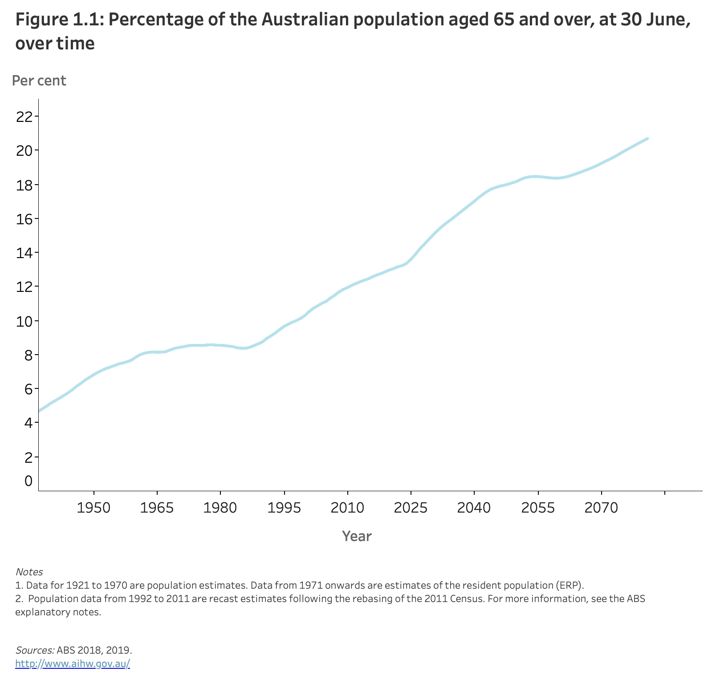
Population ageing is a success story
Notes:
2. Population ageing as a success story
Suggested image: Official ageing graph already selected from ABS/AIHW; full-width if possible
Narrative bullets:
• Population ageing was framed as evidence of longer life, better health care, and improved social and economic conditions.
• Older age was separated from assumptions of severe illness, dependency, or imminent death.
• Emergency medicine was positioned as the acute interface where the consequences of demographic success become visible.
• College-level policy and education work on ageing, access block and emergency system design was acknowledged, including ACEM emergency geriatrics activity.
References:
1. Burkett E. Emergency medicine and population ageing: a call to action. Emerg Med Australas. 2024. https://doi.org/10.1111/1742-6723.14347
2. Burkett E, et al. Trends and predicted trends in presentations of older people to Australian emergency departments: effects of demand growth, population aging and climate change. Aust Health Rev. 2016. https://doi.org/10.1071/AH15165
3. Buckinx F, et al. Burden of frailty in the elderly population: perspectives for a public health challenge. Arch Public Health. 2015. https://doi.org/10.1186/s13690-015-0068-x
4. Reid J, et al. The Australian Frailty Network: development of a consumer-focussed national response to frailty. Australas J Ageing. 2024. https://doi.org/10.1111/ajag.13365

Slide 3

Frailty is at the front door
Notes:
3. Frailty is at the front door
Suggested image: Older person at threshold / ambulance ramp / bold frailty diagram
Narrative bullets:
• Ageing was distinguished from frailty; more older people by number and proportion did not imply that most older people were frail.
• Frailty was presented as the acute phenotype increasingly visible in emergency demand.
• The Clegg definition was used to explain vulnerability to disproportionate deterioration after minor stressors.
• Frail older people were framed not as “breaking” the ED, but as revealing where the system was already brittle.
• Frailty was framed as dynamic rather than fixed, with opportunities for prevention, remediation and reversal depending on stage and context.
References:
1. Clegg A, et al. Frailty in older people. Lancet. 2013. https://doi.org/10.1016/S0140-6736(12)62167-9
2. Gill TM, et al. Transitions between frailty states among community-living older persons. Arch Intern Med. 2006. https://doi.org/10.1001/archinte.166.4.418
3. Travers C, et al. Building resilience and reversing frailty: a randomised controlled trial of a primary care intervention for older adults. Age Ageing. 2023. https://doi.org/10.1093/ageing/afad012
4. Sison CP, et al. Rethinking emergency care for older adults living with frailty. Lancet Healthy Longev. 2024. https://doi.org/10.1016/S2666-7568(24)00036-6

Slide 4
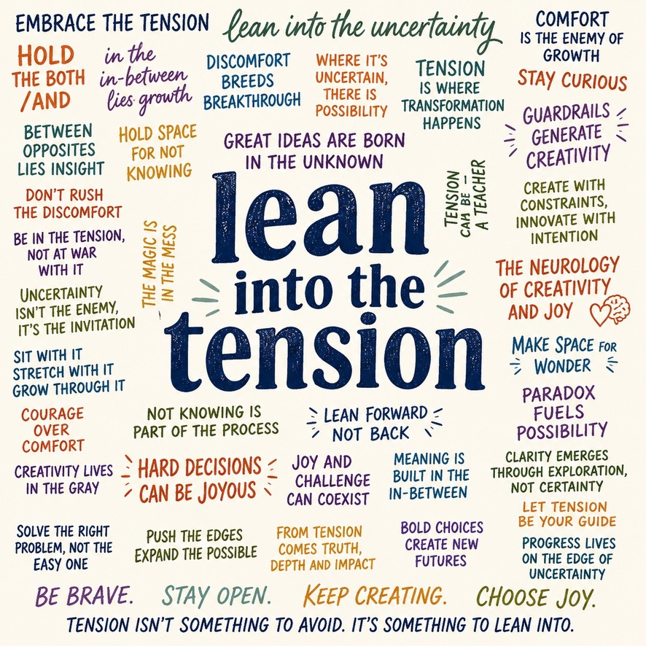
Notes:
4. Lean into the tension
Suggested image: Abseiling climber leaning back into rope, or bridge cable under load, or loom under tension
Narrative bullets:
• Constraint, uncertainty, pressure, incompleteness, and competing goods were identified as ordinary conditions of emergency medicine rather than deviations from ideal care.
• Tension was framed as something that can sharpen thinking, not only something to be resolved.
• The cognitive literature on emergency decision-making under pressure was used as the evidentiary anchor for this section.
• The Quadruple Aim was foreshadowed as a frame that reveals tension rather than resolving it, with the move from triple to quadruple framing noted conceptually.
References:
1. Pines JM, et al. Cognitive biases in emergency physicians: a pilot study. J Emerg Med. 2019. https://doi.org/10.1016/j.jemermed.2019.03.048
2. Kunitomo K, et al. Cognitive biases encountered by physicians in the emergency room. BMC Emerg Med. 2022. https://doi.org/10.1186/s12873-022-00708-3
3. Egoda Kapuralalage R, et al. Clinical decision-making: cognitive biases and heuristics in triage decisions in the emergency department. Am J Emerg Med. 2025. https://doi.org/10.1016/j.ajem.2025.02.043
4. Schubert CC, et al. Characterizing novice-expert differences in macrocognition: an exploratory study of cognitive work in the emergency department. Ann Emerg Med. 2013. https://doi.org/10.1016/j.annemergmed.2012.08.034

Slide 5
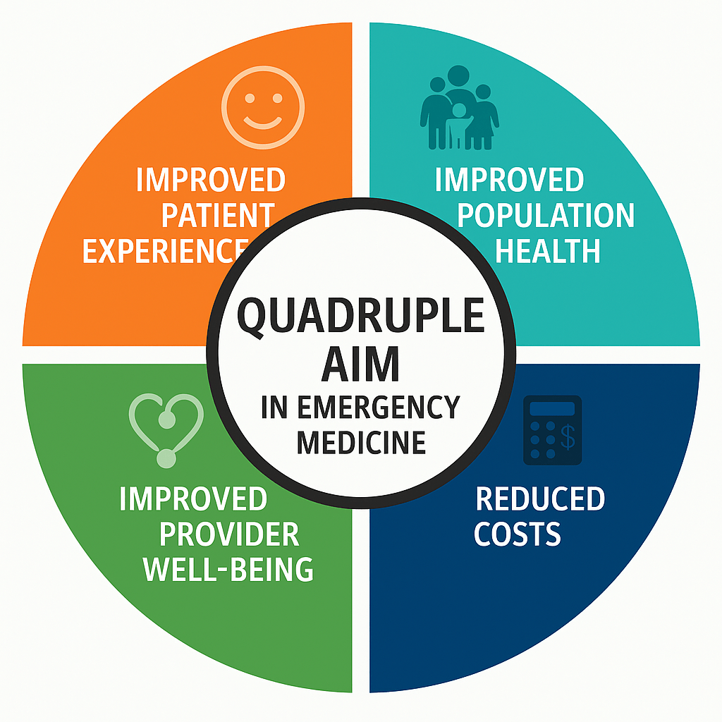
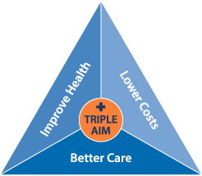
From triple aim to quadruple aim
Notes:
5. Quadruple Aim image / framing slide
Suggested image: The Quadruple Aim diagram from the current deck/blog or a cleaned equivalent from literature/policy
Narrative bullets:
• The Quadruple Aim image was displayed as a framing device rather than as a performance measure.
• Each aim was introduced as containing internal tension rather than a single stable objective.
• The four domains were identified as patient experience, population health, system performance, and provider well-being.
• The next four slides were signposted as one slide per aim.
References:
1. Bodenheimer T, Sinsky C. From triple to quadruple aim: care of the patient requires care of the provider. Ann Fam Med. 2014. https://doi.org/10.1370/afm.1713
2. Samadbeik M, et al. Patient flow in emergency departments: a comprehensive umbrella review of solutions and challenges across the health system. BMC Health Serv Res. 2024. https://doi.org/10.1186/s12913-024-10725-6
3. Carpenter CR, et al. Adapting emergency care for persons living with dementia: results of the Geriatric Emergency Care Applied Research Network scoping review and consensus conference. JAMDA. 2022. https://doi.org/10.1016/j.jamda.2022.05.016
4. Rosenberg MS, et al. Geriatric emergency department guidelines. Ann Emerg Med. 2014. https://doi.org/10.1016/j.annemergmed.2014.02.008

Slide 6

Aim 1 – Patient Experience
Notes:
6. Aim 1 — patient experience
Suggested image: Bedside conversation; frail older person plus family/supporter; symbolic split-image of “the person you can see / the queue behind them”
Narrative bullets:
• Patient experience was framed as a tension inside the aim itself.
• A good individual encounter for a frail older person was identified as time-intensive by definition: 5Ms, baseline cognition, supporter involvement, supported decision-making, and “what matters most”.
• That same time was identified as impacting every other person waiting to be seen, or the department’s capacity to respond elsewhere.
• Person-centred care was complicated by the recognition of fluid, ongoing selfhood rather than a fixed identity in dementia.
• Dignity of risk and supported decision-making were introduced as emerging but under-explored priorities for emergency care.
References:
1. Chary AN, et al. Emergency department communication with diverse caregivers and persons living with dementia: a qualitative study. J Am Geriatr Soc. 2024. https://doi.org/10.1111/jgs.18897
2. Gettel CJ, et al. A qualitative study of “what matters” to older adults in the emergency department. West J Emerg Med. 2022. https://doi.org/10.5811/westjem.2022.4.56115
3. Chapman M, Philip J, Komesaroff P. A person-centred problem. Humanit Soc Sci Commun. 2022. https://doi.org/10.1057/s41599-022-01166-9
4. Donnelly M. Deciding in dementia: the possibilities and limits of supported decision-making. Int J Law Psychiatry. 2019. https://doi.org/10.1016/j.ijlp.2019.101466
5. Foundas M. Dignity of risk in residential aged care: a call to reframe understandings of risk. Med J Aust. 2025. https://doi.org/10.5694/mja2.70002

Slide 7

Aim 2 – Population Health
Notes:
7. Aim 2 — population health
Suggested image: ED as safety net / upstream-downstream flow / RACF, GP, ambulance, ED
Narrative bullets:
• Population health was framed as what the ED sees when upstream systems have already failed or thinned.
• Primary care gaps, aged care gaps, after-hours resource gaps, social support gaps and fragmented care were identified as part of emergency demand.
• Injurious falls were presented as rising before and around dementia diagnosis, making the fall potentially already a conversation about cognition.
• “Mechanical falls” language was identified as a source of anchoring bias that obscures frailty, cognition, polypharmacy and accumulated vulnerability.
• Prevention was placed in tension with proportionate care, especially in advanced dementia and severe frailty.
References:
1. Zhang L, et al. Injurious falls before, during and after dementia diagnosis: a population-based study. Age Ageing. 2022. https://doi.org/10.1093/ageing/afac299
2. Nagaraj G, et al. Avoiding anchoring bias by moving beyond “mechanical falls” in geriatric emergency medicine. Emerg Med Australas. 2018. https://doi.org/10.1111/1742-6723.13129
3. Iaboni A, et al. A palliative approach to falls in advanced dementia. Am J Geriatr Psychiatry. 2018. https://doi.org/10.1016/j.jagp.2017.11.014
4. Brennan F, et al. Our dementia challenge: arise palliative care. Intern Med J. 2023. https://doi.org/10.1111/imj.16011

Slide 8

Aim 3 – System Performance
Notes:
8. Aim 3 — system performance
Suggested image: Blocked patient flow / ramping / corridor / ward-discharge graphic / hospital dashboard
Narrative bullets:
• Throughput-only thinking was identified as too narrow for frailty-informed emergency care.
• Access block, ambulance ramping and bed occupancy were framed as whole-of-system problems rather than ED process failures alone. The recent MJA work especially “banana in the tail pipe” is a direct challenge – the banana that’s in the tailpipe is disproportionately made up of older people and people with disabilities needing accommodation that matches their needs.
• Throughput was placed in tension with thoroughness, with explicit attention to collateral history “what is this person like at their baseline”, cognition, family involvement, and “what matters most”.
• Queensland older-person exemplars such as GEDI, CAREPACT and RaSS were referenced as whole-of-continuum models rather than isolated ED interventions – but they assist in providing the additional elements to improve the quality of care in the ED – as well as attempting to alleviate demand.
• Implementation success was framed as dependent on context, leadership, capability, and knowledge exchange rather than intervention content alone.
References:
1. Yoon H-J, et al. The association between access block and ambulance ramping, and the impact of COVID-19: a retrospective observational cohort study of 25 Queensland hospitals. Med J Aust. 2026. https://doi.org/10.5694/mja2.70141
2. Riahi V, et al. The impact of hospital bed occupancy on patient flow and emergency department access: a 25-hospital cohort study. Med J Aust. 2026. https://doi.org/10.5694/mja2.70143
3. Hassanzadeh H, et al. Strategies for reducing access block and waiting time for patients seeking emergency hospital care: results of a ward-level discrete event simulation at Queensland’s largest public hospitals. Med J Aust. 2026. https://doi.org/10.5694/mja2.70142
4. Wallis M, et al. The Geriatric Emergency Department Intervention model of care: a pragmatic trial. BMC Geriatr. 2018. https://doi.org/10.1186/s12877-018-0992-z
5. Koerner J, et al. Context and mechanisms that enable implementation of specialist palliative care Needs Rounds in care homes: results from a qualitative interview study. BMC Palliat Care. 2021. https://doi.org/10.1186/s12904-021-00812-4

Slide 9

Aim 4 – Provider Wellbeing
Notes:
9. Aim 4 — provider well-being
Suggested image: Fatigued clinician at workstation / humane but strained ED image / cognitive load visual
Narrative bullets:
• Provider well-being was framed as the aim added last and measured least.
• It was positioned as a necessary precondition of better care rather than an optional extra.
• Burnout was framed not only as a morale issue, but as a cognitive and clinical problem.
• Reduced safety-related quality, impaired attention, working memory and executive function were identified as especially relevant to older-person emergency care.
• Endurance was placed in tension with sustainability, with the claim that older-person care often erodes first when workforce condition erodes.
References:
1. Dewa CS, et al. The relationship between physician burnout and quality of healthcare in terms of safety and acceptability: a systematic review. BMJ Open. 2017. https://doi.org/10.1136/bmjopen-2016-015141
2. Gavelin HM, et al. Clinical burnout and cognitive functioning: a systematic review and meta-analysis. Work Stress. 2022. https://doi.org/10.1080/02678373.2021.2002972
3. Wolfshohl JA, et al. Association between empathy and burnout among emergency medicine physicians. J Clin Med Res. 2019. https://doi.org/10.14740/JOCMR3878
4. Persico N, et al. Influence of shift duration on cognitive performance of emergency physicians: a prospective cross-sectional study. Ann Emerg Med. 2018. https://doi.org/10.1016/j.annemergmed.2017.10.005

Slide 10

Final challenge – ageism, burnout and research
Notes:
10. Final challenge — ageist language, burnout, and the close
Suggested image: Reflective image: empty staff room after shift / clinician silhouette / speech bubble / quiet return to Quadruple Aim image in background
Narrative bullets:
• Off-the-cuff ageist language was framed as behaviour that should not be collapsed into the whole identity of the clinician who used it.
• A distinction was made between explanation and excuse: the behaviour was not defended, but its conditions of emergence were treated as worthy of study.
• The age-positive language literature was used to argue that words matter for older-person outcomes.
• Burnout, cognitive strain and empathy erosion were introduced as plausible contributors to depersonalising or dismissive language in ED settings.
• A final research challenge was posed: the direction and strength of association between burnout and ageist language in emergency care remains to be measured.
• The close returned to the central claim that the frail older person makes all four tensions visible at once, and that designing for this cohort designs a better ED for everyone.
References:
1. Alsaba N, et al. Words and language matter: improving older person’s healthcare outcomes through use of age-positive language. Emerg Med Australas. 2026. https://doi.org/10.1111/1742-6723.70295
2. Goodwin J, et al. How do emergency department staff respond to behaviour that challenges displayed by people living with dementia? A mixed-methods study. BMJ Open. 2023. https://doi.org/10.1136/bmjopen-2023-075022
3. Oliveira D, et al. Experiences of stigma and discrimination among people living with dementia and family carers in Brazil: qualitative study. Ageing Soc. 2021. https://doi.org/10.1017/S0144686X21000660
4. Kane M, et al. Assessing implicit and explicit dementia stigma in young adults and care-workers. Dementia. 2020. https://doi.org/10.1177/1471301218804727
5. Ting HH, et al. Biased language in simulated handoffs and clinician recall and attitudes. JAMA Netw Open. 2024. https://doi.org/10.1001/jamanetworkopen.2024.50172

